Slide 1

Project based on Digital Signature Scheme
(ElGamal Digital Signature)
Presented by :
Taran Mamidala - 19BCE7346
J.D.S Charan - 19BCE7176
K.Praneeth - 19BCE7241
Mohammad Arshad - 19BCE7343

Slide 2
Abstract
A powerful and practical public-key and digital signature scheme was produced by ElGamal.We implement the classical and modified ElGamal digital signature scheme to compare and to test their functionality, reliability and security.

Slide 3
Objectives
The objective of the proposed project is to design an ElGamal digital signature algorithm such that the time complexity of the algorithm is reduced and the security is kept high.
Earlier improvement was made by adding a random number to the original algorithm because of which security was increased. But time complexity was still high.

Slide 4
Introduction
The ElGamal cryptosystem was first described by Taher Elgamal in 1985 and is closely related to the Diffie-Hellman key exchange. The Diffie-Hellman key exchange provides a method of sharing a secret key between Alice and Bob, but does not allow Alice and Bob to otherwise communicate securely.
Cryptographically secure digital signature schemes are formed of two parts, the signing protocol and the authentication process.

Slide 5
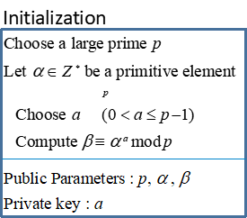
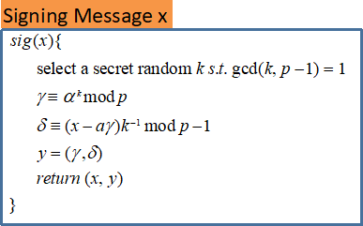
ElGamal Signature Scheme
The use of a random secret k for every signature makes ElGamal non-deterministic

Slide 6
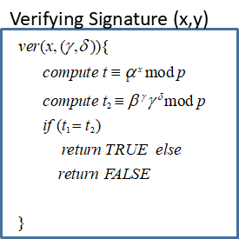
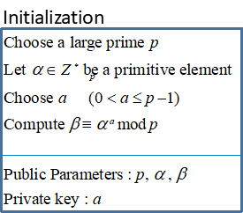
ElGamal Verifying
Try a demo of the encryption scheme here : CLICK here

Slide 7
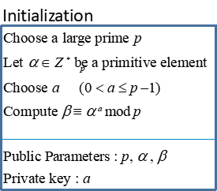
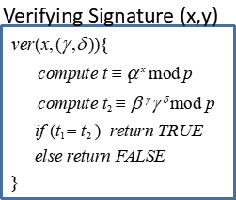
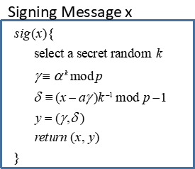
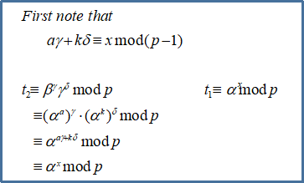
ElGamal Correctness
if the signature is valid, t1 = t2
correctness

Slide 8
CODE :
import java.util.Scanner; public class Main { public static void main(String[] args) { Scanner sc = new Scanner(System.in); System.out.println("Enter the value of p"); long p = sc.nextLong(); System.out.println("Enter the value of alpha"); long alpha = sc.nextLong(); System.out.println("Enter the value of m"); long m = sc.nextLong(); System.out.println("Enter the value of k"); long k = sc.nextLong(); signAlgo sign = new signAlgo(p, alpha, m, k); verify v = new verify(sign.p, sign.alpha, sign.beta, sign.m, sign.r, sign.s); v.verified(); } }

Slide 9
class signAlgo { public long p, alpha, beta, m, r, s, k; private long z = 16; signAlgo(long a, long b, long c, long d) { p = a; alpha = b; beta = ((long) Math.pow(alpha, z)) % p; m = c; k = d; //createK(); r = createS1(alpha, k); s = createS2(); } long gcd(long a, long b) { if (a < b) return gcd(b, a); else if (a % b == 0) return b; else return gcd(b, a % b); }

Slide 10
long invK() { for (int x = 1; x < p - 1; x++) if ((k * x) % (p - 1) == 1) return x; return 1; } long createS1(long b, long c) { long a = ((long) Math.pow(b, c)); if (a < (long) Math.pow(2, 36) - 1) return a % p; else //(a==(long)Math.pow(2, 36)-1) return (createS1(b, c / 2) * createS1(b, c - c / 2)) % p; } long createS2() { long a = (invK() * (m - z * r)) % (p - 1); if (a >= 0) return a; else return (a + p - 1); }

Slide 11
} class verify { public long p, alpha, beta, m, r, s; verify(long a, long b, long c, long d, long e, long f) { p = a; alpha = b; beta = c; m = d; r = e; s = f; } long v1(long b, long c, long d, long e) { long a = (((long) Math.pow(b, c)) * ((long)(Math.pow(d, e)))); if (a < (long) Math.pow(2, 36) - 1) return a % p; else //(a==(long)Math.pow(2, 36)-1) return (v1(b, c / 2, d, e / 2) * v1(b, c - c / 2, d, e - e / 2)) % p; }

Slide 12
long v2() { return (((long) Math.pow(alpha, m)) % p); } long v2(long b, long c) { long a = ((long) Math.pow(b, c)); if (a < (long) Math.pow(2, 36) - 1) return a % p; else //(a==(long)Math.pow(2, 36)-1) return (v2(b, c / 2) * v2(b, c - c / 2)) % p; } void verified() { if (v1(beta, r, r, s) == v2(alpha, m)) { System.out.println("Signature verified using ElGamal."); System.out.println("The value of v1 mod p: " + v1(beta, r, r, s)); System.out.println("The value of v2 mod p: " + v2(alpha, m)); } else { System.out.println("Signature missmatch"); System.out.println("The value of v1 mod p: " + v1(beta, r, r, s)); System.out.println("The value of v2 mod p: " + v2(alpha, m)); } } }

Slide 13
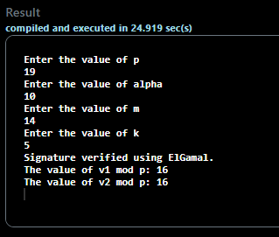
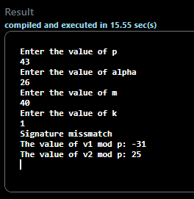
Output :

Slide 14
Implementation Details
The signing protocol for an ElGamal signature is as follows. Suppose Alice wants to sign a message, m.
The initial setup is the same as that for ElGamal encryption.
Alice chooses a large prime p and a primitive root α.
She then chooses a secret integer z and calculates β ≡ αz (mod p).
The values of p, α and β are made public and z is kept private.
In order to sign the message m Alice follows the steps below:
She selects a secret random integer k such that GCD(k, p – 1) = 1.
She then computes r ≡ αk (mod p).
She then finally computes s ≡ k-1(m – zr) (mod p – 1).
The signed message is the triplet (m, r, s).

Slide 15
The verification process can then be performed by Bob using public information only.
Bob computes v1 ≡ (β^r)*(r^s) (mod p) and v2 ≡ (α^m) (mod p).
The signature is declared valid if and only if v1 ≡ v2 (mod p).
Correctness
The verification procedure works by the following argument. Assume that the signature is valid. As s ≡ k-1(m – zr) (mod p – 1), we have sk ≡ (m – zr) (mod p – 1) and hence m ≡ sk + zr (mod p – 1). Therefore by Fermat’s little theorem, that a congruence mod p – 1 in the exponent yields a congruence mod p overall, we have:
v2 ≡ (α^m) ≡ (α^(sk+zr)) ≡ (α^(sk))(α^(zr)) ≡ (β^r)(r^s) ≡ v1 (mod p)

Slide 16
Problem Statement
problem‐based ElGamal public‐key encryption and signature schemes that exhibit strong security features and efficient implementation

Slide 17
Literature Survey and Inference
ElGamal digital signature is the asymmetric approach of authentication mechanism based on discrete logarithm problem. This technique uses as the universally known random number that serves as the generator, u as the universally known prime number that serves as the modulus,H() as the universally known hash function

Slide 18
Motivation
The ElGamal signature scheme is known as a signature with appendix: the message is not readily recovered from the signature pair (r, s) and the message m must be included in the verification procedure. This is in contrast to a message recovery scheme where in the message is easily recoverable from the signature.

Slide 19
Conclusion
The private knowledge required to sign a document is solely represented by the integer z and hence this must be kept secret as in the ElGamal signature scheme.
Most signature schemes including ELGamal signature mode do not allow message recovery. Based on ELGamal signature mode, an improved scheme was proposed, which allows message recovery and has better security than the original one.

